Slide 1
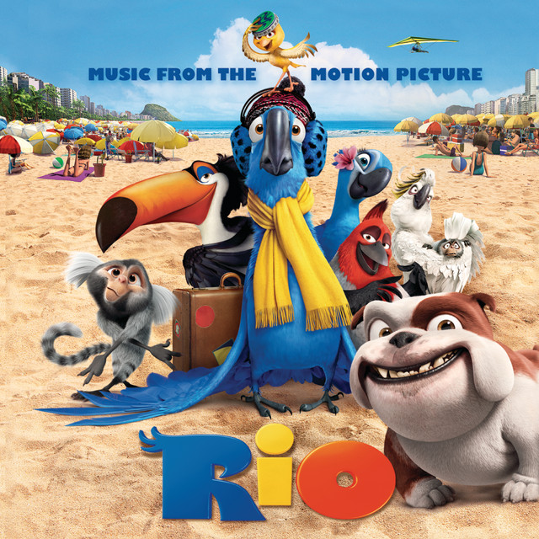
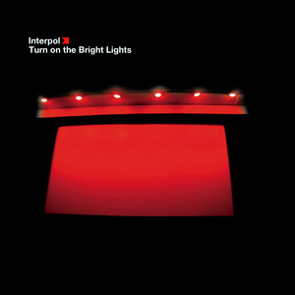
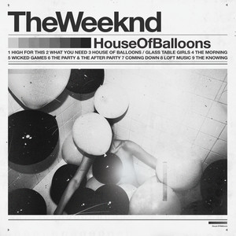
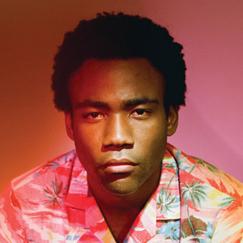
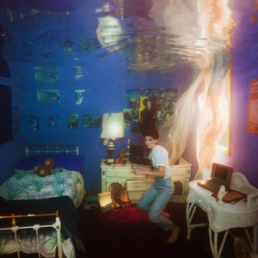
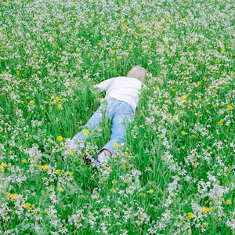
Your Spring ‘24
Albums

Slide 2
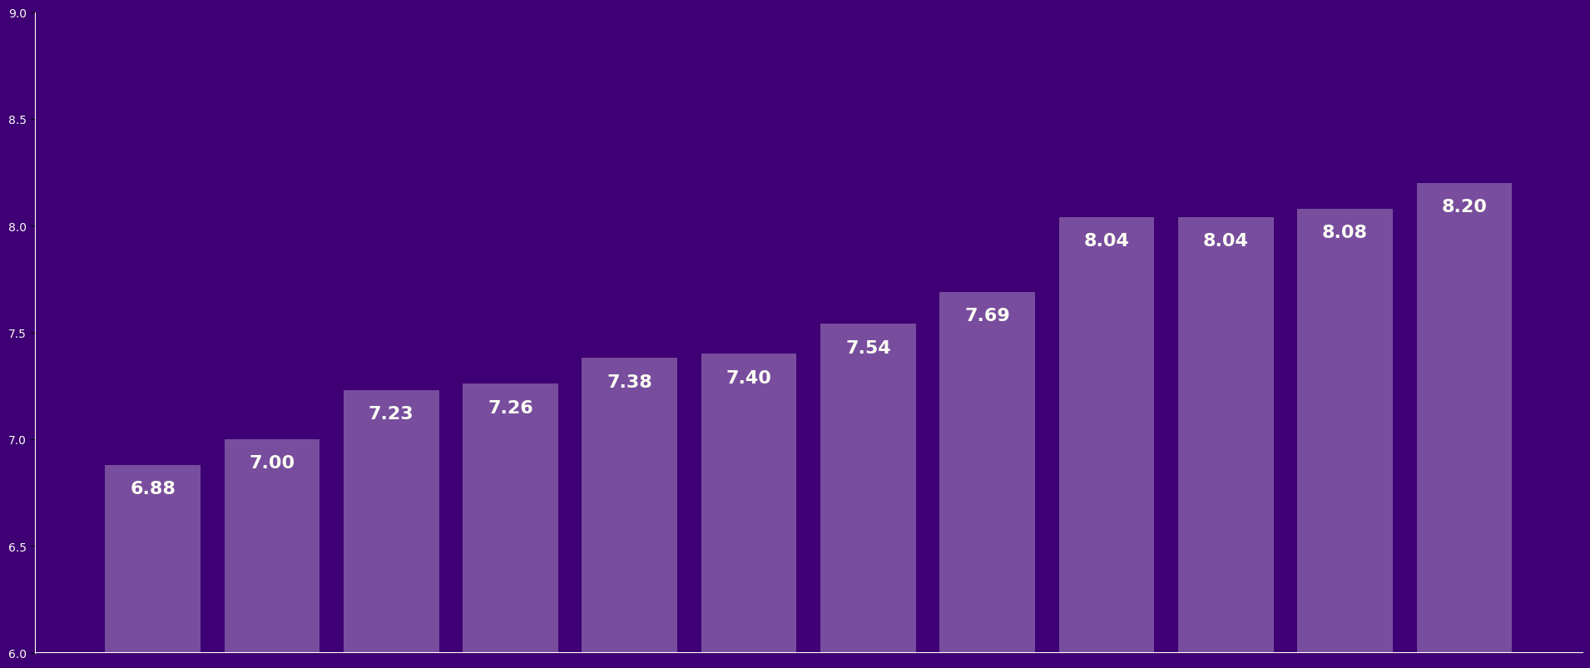
Average Score
7.56
Score Averages
Notes:
Also worth mentioning:
Funny enough, the highest rated album this semester isn't even in the top-10 highest ratings of all time
This statistic counts summer discussions, even though summer ratings tend to be more volatile and less reflective of the whole org because of lower attendance.
If we choose to exclude summer discussions, Titanic Rising becomes the 6th highest rated album in club history.
Only Lauryn Hill (Fall '22, 8.94), GKMC (Spring '23, 8.92), TPAB (Fall '23, 8.84), Amy Winehouse (Fall '22, 8.50), and AFUT (Fall '22, 8.43) surpass it.
The overall range of scores of 1.32 (6.88 - 8.20) is lower than any other semester in the club's history.

Slide 3
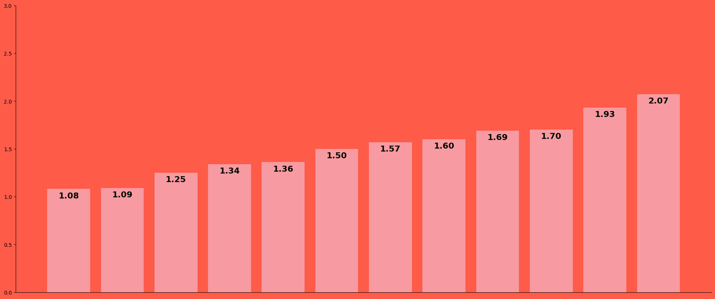
Average Stdev
1.52
Score Standard Deviations
Notes:
Also worth mentioning:
The House of Balloons 1.08 standard deviation is the highest minimum standard deviation AOTW has had in its history.
This is a great sign for the club, since it shows that AOTW has cultivated a safe environment where people are free to discuss their true opinions without fear of harassment.
Only two albums in the ("modern") AOTW era have a higher controversy score than Rio: For the first time by BC,NR (2.15) and Whole Lotta Red by Playboi Carti (2.50)
The original TPAB rating does have a 2.86 stdev, but also it's unfair to consider this since this was before the club was even officially recognized by A&M and also 6 people came to that meeting anyways

Slide 4
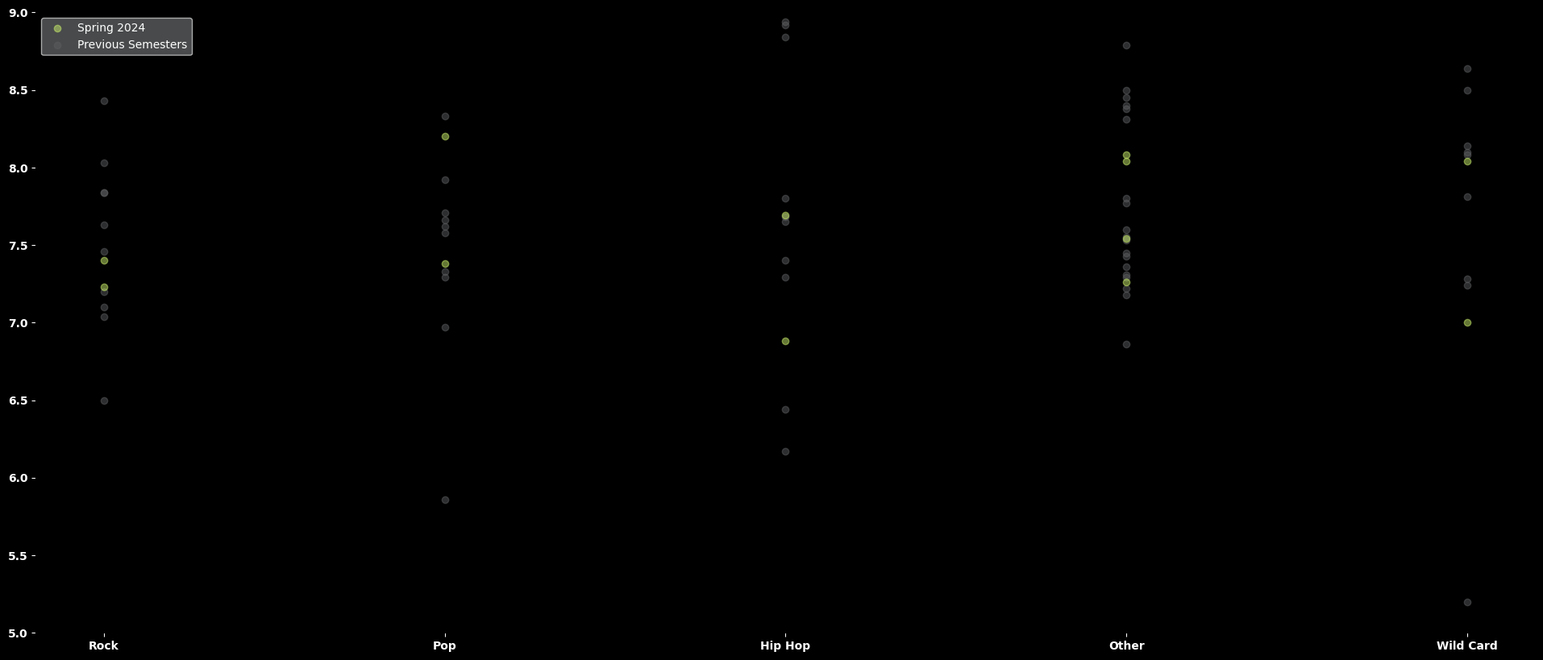
Genre vs. Score
*counting Special Week albums under the "Other" category
Notes:
Also worth mentioning:
Weyes Blood being the highest rated pop album in (post-Summer '22) AOTW history, even with a high attendance of 55 people
Probably not worth mentioning but I'll still put it here:
The Rio soundtrack is the lowest-scoring wild card album in (post-Summer '22) club history

Slide 5
Genres
AOTW members listened to 29 sub-genres this Spring, with lighter purple indicating genres that were discussed for the first time this semester!
Alternative Hip Hop Baroque Pop Concerto Electropop Hardcore Hip Hop Industrial Hip Hop Noise Pop Post-Rock Southern Hip Hop Twee Pop | Alternative R&B Brazilian Music Downtempo Experimental Hip Hop Indie Pop Jazz Pop Post-Punk Shoegaze Synthpop West Coast Hip Hop | Baroque Music City Pop EDM Film Soundtrack Indie Rock New Music Post-Punk Revival Singer-Songwriter Trap
Notes:
29 subgenres is a record number of subgenres in a single semester

Slide 6
Diversity of Decades
AOTW members listened to music spanning 296 years!
Thanks to the power of outliers, the oldest album discussed this semester was The Four Seasons by Antonio Vivaldi, published in 1725! The most recent album discussed this semester was Nurture by Porter Robinson, released in April 2021.
The time span of 296 years is the largest in AOTW history, quadrupling the previous all-time record of 65 years set by Summer 2023 (1955-2020).
In spite of the massive outlier, 10 of the 12 albums were released in the 21st century! In fact, the majority of discussions were by albums released in the 2010s, with 7 total albums and an average score of 7.63 amongst them.
With the discussions of The Money Store and Nurture, the years of 2012 and 2021 are tied for the year with the most albums featured as AOTW, with 5 albums each.
Published 1725
Released 2021
Notes:
In spite of what the range suggests, only 2 of the 12 albums were made before the 21st century: Mignonne (1978) and The Four Seasons (published by Vivaldi in 1725, recorded by Israel Philharmonic in 1985). Every other album we discussed this semester was made after the year 2000.
In case you're curious about what albums we discussed for "year with the most albums featured as AOTW", in order of discussion:
2012: Night Visions, Bloom, channel ORANGE, good kid m.A.A.d city, and The Money Store
2021: By The Time I Get To Phoenix, To See The Next Part of the Dream, For the first time, Blue Banisters, and Nurture

Slide 7
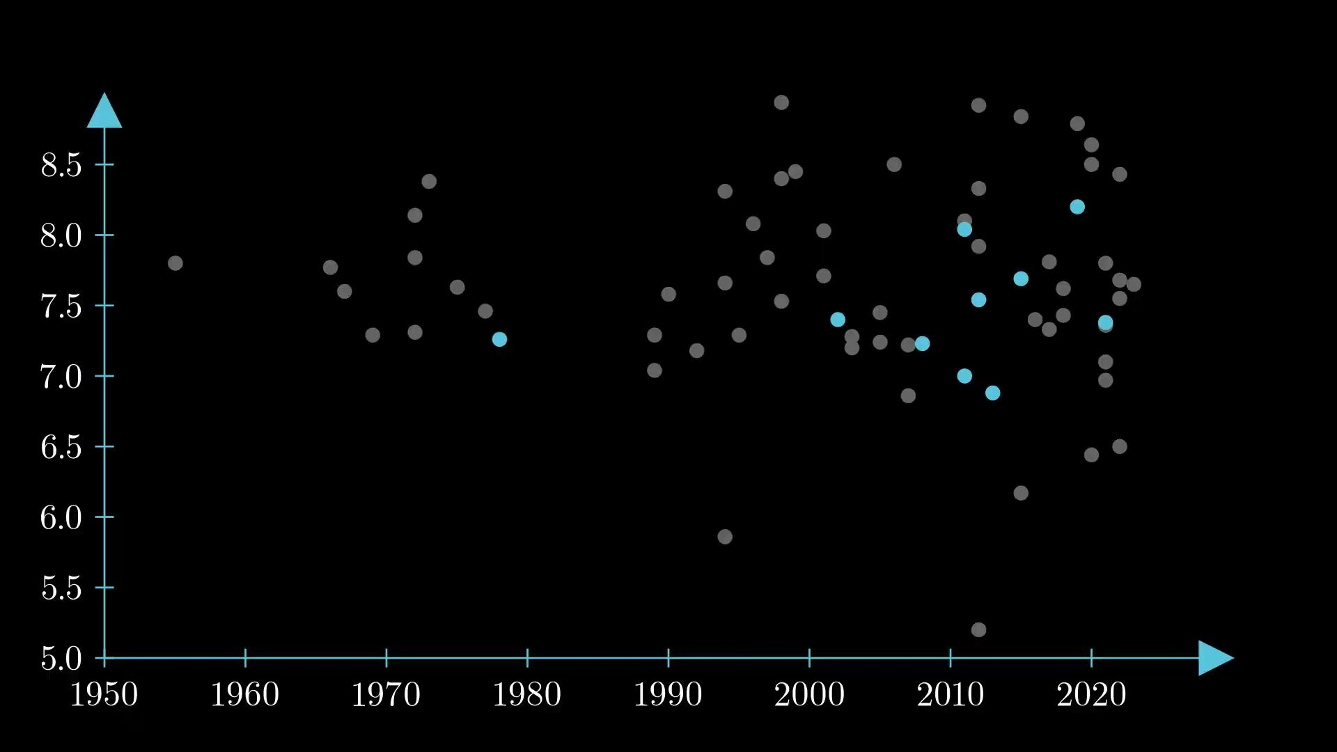
Just to put it in perspective…
Notes:
3blue1brown-ass transition
This is a graph of album release years vs. album score
Dots in blue are for albums discussed this semester, dots in grey are for every other semester

Slide 8
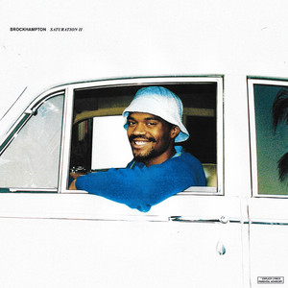
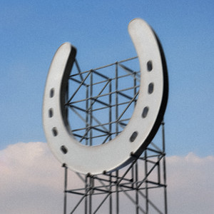
Nominations
In Spring 2024, members made a total of 337 nominations! Every nomination from this semester is currently flashing in the top right corner as a GIF, do you see your nominations?
Of the 269 unique albums, 3 were nominated a whopping 4 times, more than any other album!
BROCKHAMPTON - SATURATION II
Kero Kero Bonito - Time 'n' Place
underscores - Wallsocket
Of the 246 unique artists, BROCKHAMPTON had 4 different albums nominated, more than any other artist! The four included: SATURATION II, SATURATION III, iridescence, and ROADRUNNER. On top of that, 3 more artists had 3 different albums nominated.
Bob Dylan (Blonde on Blonde, Blood on the Tracks, Desire)
Lady Gaga (The Fame/The Fame Monster, ARTPOP, Chromatica)
The Weeknd (House of Balloons, Thursday, Dawn FM)
Total Number of Nominations
337
Number of Unique Albums Nominated
269
Number of Unique Artists Nominated
246
Notes:
Also worth mentioning:
Albums frequently nominated tend to eventually become AOTW!
All 4 of Spring 2023's most nominated eventually had discussions (Weezer, Give Up, 98.12.28, Blue Banisters)
4 of the 6 most nominated in Fall 2023 eventually had discussions (Titanic Rising, Atrocity Exhibition, Turn On The Bright Lights, Rodeo)
[EXTRA] Of the 268 albums, on top of 3 albums being nominated four times:
220 were nominated just once
30 were nominated twice
15 were nominated three times. In case you're curious, these albums were:
Bladee - Icedancer
Chappell Roan - The Rise and Fall of a Midwest Princess
Death Grips - The Money Store
Depeche Mode - Violator
Freddie Gibbs - Piñata
George Clanton - Slide
Lady Gaga - ARTPOP
Mid-Air Thief - Crumbling
Nine Inch Nails - The Downward Spiral
PinkPantheress - Heaven knows
Queens of the Stone Age - Songs For The Deaf
Sewerslvt - Draining Love Story
The Avalanches - Since I Left You
Weezer - Pinkerton

Slide 9
Notes:
ARTISTS BY LOCATION:
California: Weyes Blood (Santa Monica), Childish Gambino (Edwards Air Force Base), Death Grips (Sacramento)
Houston, TX: Travis Scott
Atlanta, GA: Porter Robinson
Northeastern Corridor: Interpol (New York City, NY), Have A Nice Life (Middletown, CT)
Toronto, Canada: The Weeknd
Rio de Janeiro, Brazil: Sergio Mendes (lead composer of Rio soundtrack)
London, United Kingdom: Kero Kero Bonito
Venice, Italy: Antonio Vivaldi
Tokyo, Japan: Taeko Onuki

Slide 10
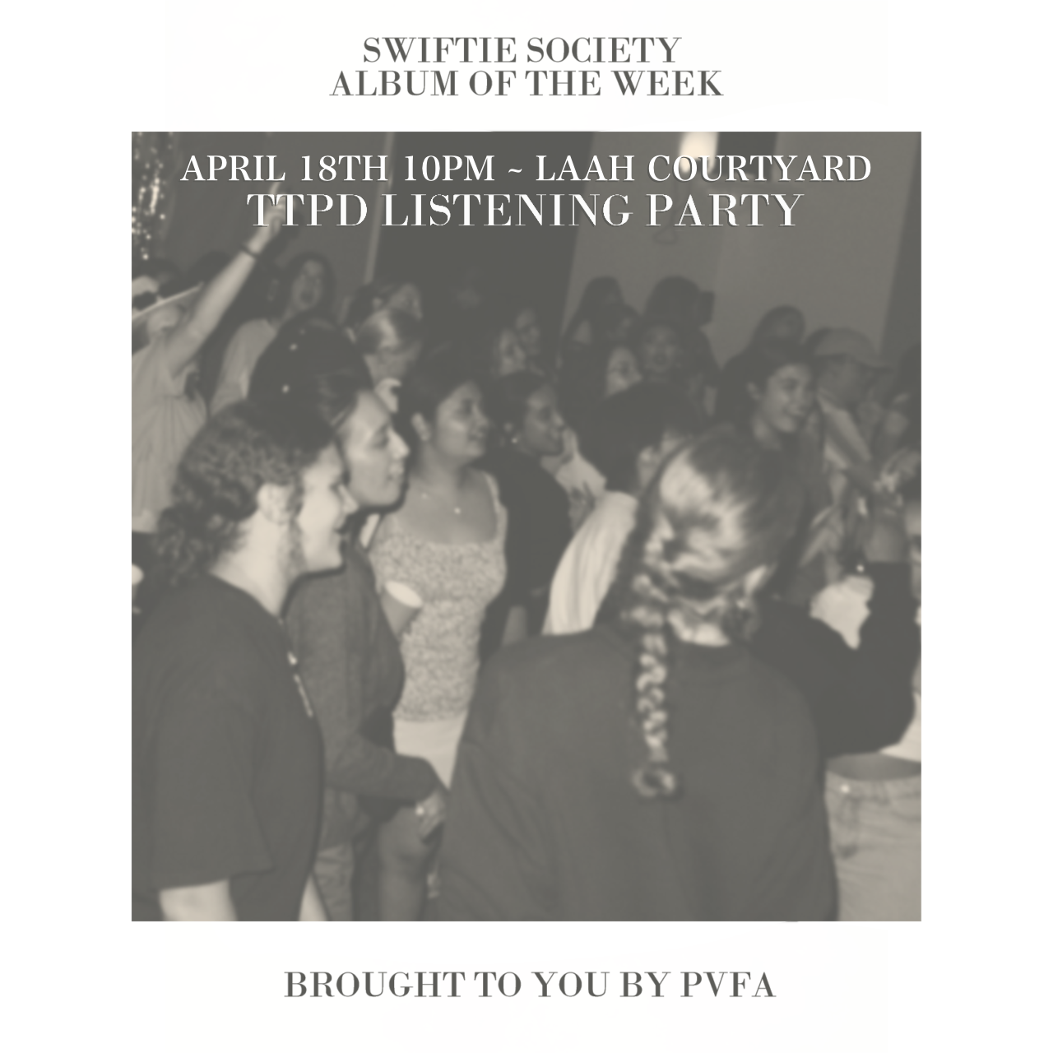
AOTW Collaborations
AOTW x Aggies in Graphic Arts
March 7, 2024
Collab with AIGA to listen to Deathconsciousness and create DIY album covers
AOTW x Japanese Cultural Association
April 8, 2024
Collab with JCA to share Japanese culture and listen to Mignonne
First AOTW discussion done in collaboration with another student org!
AOTW x TAMU Swiftie Society
April 18-19, 2024
2nd collab with TAMU Swiftie Society to celebrate the release of The Tortured Poets Department
AOTW x Aggie Data Science Club
[Semester-long event]
Collab with ADSC to build an album rec system for the AOTW website
In development by automation, To be released Fall 2024
Notes:
AIGA
Anything else from that meeting?
JCA
Swiftie Society
ADSC
Algorithm is decided, Rec system to be implemented before next fall

Slide 11
Spring 2024 Summary
Top Albums
#1 Titanic Rising
#2 The Four Seasons
#3 House of Balloons
#4 Time 'n' Place
#5 Rodeo
Top Songs
#1 Hacker
#2 Andromeda
#3 90210
#4 House of Balloons
#5 Only Acting
Average Album Score
7.56
Total Minutes Listened
23,409
tamuaotw.com
tamu aotw
Notes:
Total Minutes Listened: Sum[ (album_i length in minutes) * (discussion attendance for album_i) ].
Inherently assumes every member present at the meeting listens to an album exactly once. Although this is nowhere near an accurate metric to reality, it's just a fun way to quantify the minutes listened by the whole org.

